Slide 1


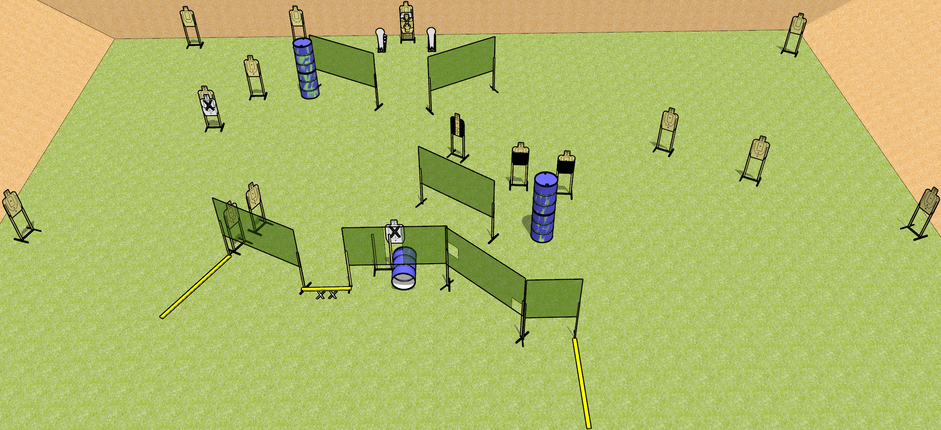
 | Dothan Gun Club – USPSA Match Down Low Course Designer : Drew Coleman
Round Count 34 rounds 16 USPSA targets 2 Colt poppers
Equipment List 14 wall feet Barrel with nail holes drilled in the side 1 medium fault line

Slide 2
Down Low
Written Stage Briefing
Down Low is a 34 round, 170 point, Comstock field course. There are 16 USPSA targets and 2 colt poppers. The best 2 hits on paper will score, and steel must fall to score. The start signal is audible.
Handgun start position is both feet on X’s, wrists below belt. Handgun is loaded and holstered.
PCC start position is both feet on X’s. Loaded carbine is held with both hands, stock on belt, safety on.
On start signal, engage targets as they become available from within the shooting area.

